Slide 1
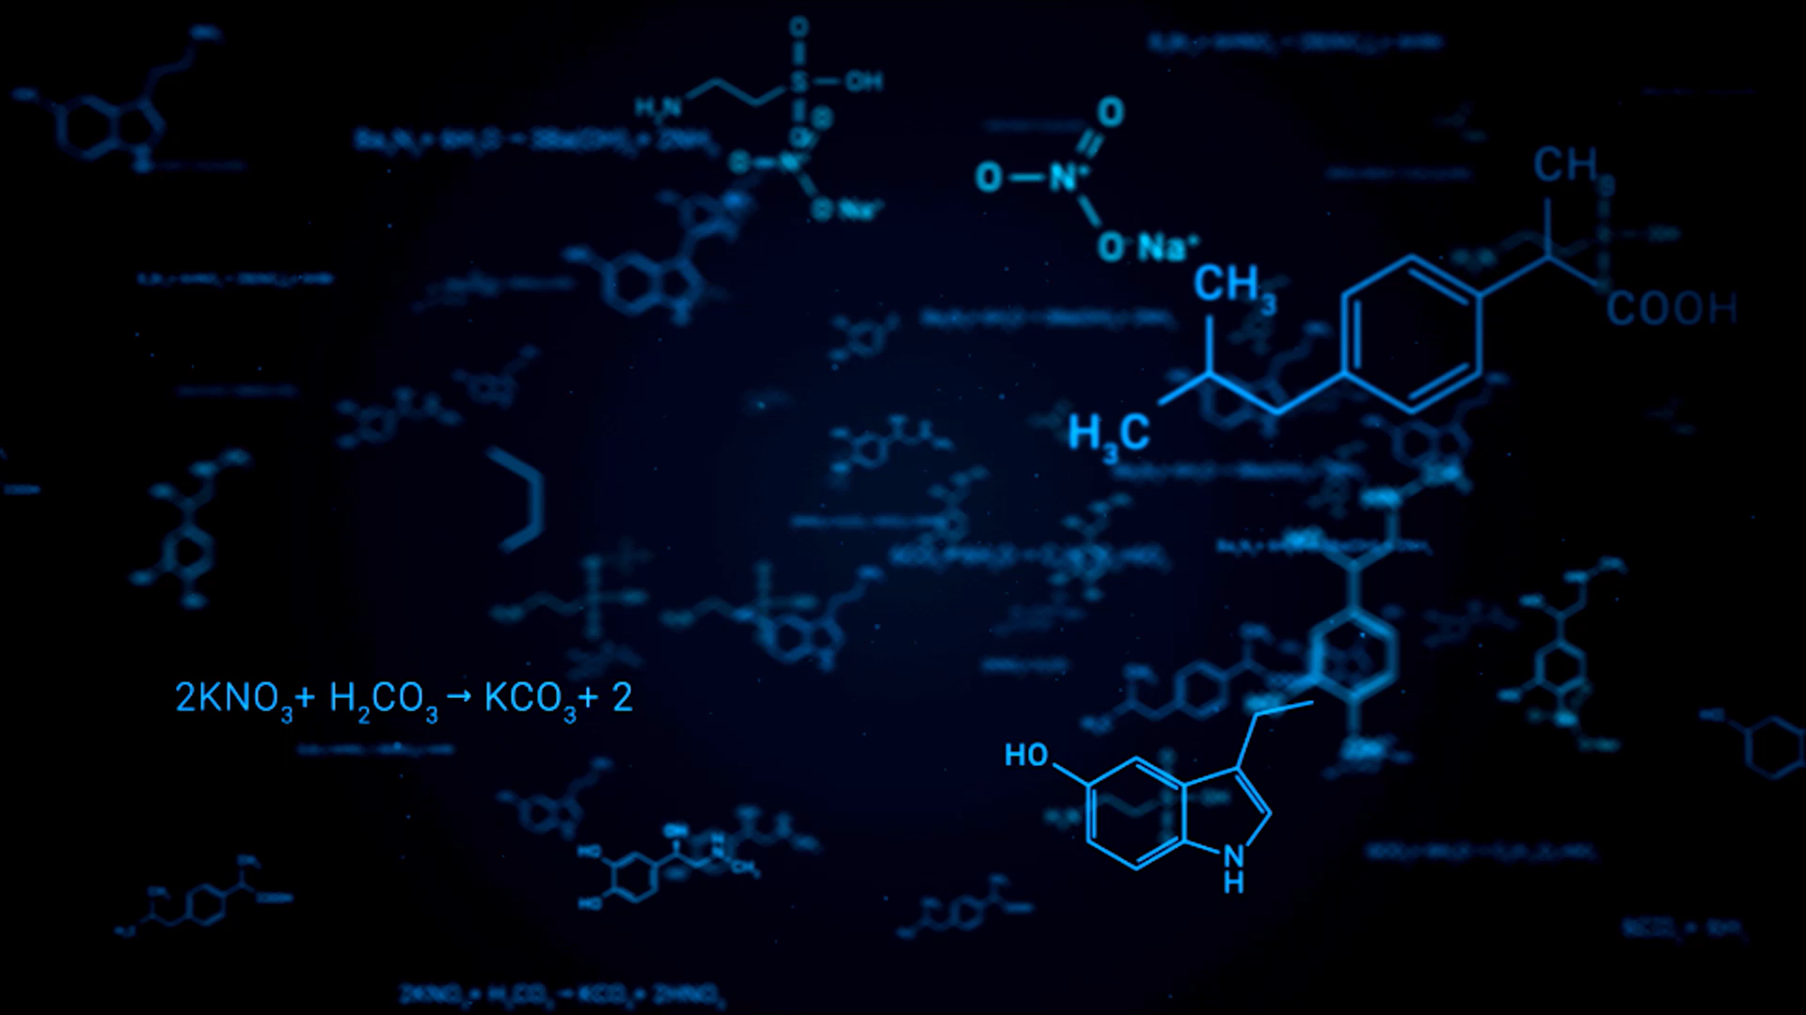
Basic AI/ML

Slide 2
Learning from Examples
Learning Agents
Machine Learning
Simple Linear Regression
Model, Parameters, Loss function
Finding the Best Fit
Multiple Regression
Modeling Seasonal Trends
General Model with D-features
Estimating Optimal Parameters
Closed Form Solution
Gradient Descent

Slide 3
Learning Agents
An agent is learning if it improves its performance after making observations about the world

Slide 4
Machine Learning
A computer observes some data, builds a model based on the data, and uses the model as both a hypothesis about the world and a piece of software that can solve problems

Slide 5
Forms of Learning ML can improve any component of an agent program
The improvements, and the techniques used to make them, depends on:
Which component is to be improved
Agent’s prior knowledge
Available data and feedback on that data

Slide 6
Forms of Learning Components of different agent designs Recap
A direct mapping from conditions on the current state to actions
A means to infer relevant properties of the world from the percept sequence
Information on how the world evolves and result of the agent actions
Utility information- desirability of world states
Notes:
Consider a self-driving car agent that learns by observing a human driver. Every time the driver brakes, the agent might learn a condition–action rule for when to brake (component 1). By seeing many camera images that it is told contain buses, it can learn to recognize them (component 2). By trying actions and observing the results—for example, braking hard on a wet road—it can learn the effects of its actions (component 3). Then, when it receives complaints from passengers who have been thoroughly shaken up during the trip, it can learn a useful component of its overall utility function (component 4).

Slide 7
Forms of Learning Components of different agent designs Recap
Action-value information indicating the desirability of actions
Goals that describe the most desirable states
A problem generator, critic, and learning element that enable the system to improve

Slide 8
Why Machine Learning?
Why not just program it the right way to begin with?
Notes:
There are two main reasons. First, the designers cannot anticipate all possible future situations. For example, a robot designed to navigate mazes must learn the layout of each new maze it encounters; a program for predicting stock market prices must learn to adapt when conditions change from boom to bust. Second, sometimes the designers have no idea how to program a solution themselves. Most people are good at recognizing the faces of family members, but they do it subconsciously, so even the best programmers don’t know how to program a computer to accomplish that task, except by using machine learning algorithms.

Slide 9
Why Machine Learning?
Why not just program it the right way to begin with?
Two main reasons:
Need to anticipate all future situations
The solution might not be known
Notes:
There are two main reasons. First, the designers cannot anticipate all possible future situations. For example, a robot designed to navigate mazes must learn the layout of each new maze it encounters; a program for predicting stock market prices must learn to adapt when conditions change from boom to bust. Second, sometimes the designers have no idea how to program a solution themselves. Most people are good at recognizing the faces of family members, but they do it subconsciously, so even the best programmers don’t know how to program a computer to accomplish that task, except by using machine learning algorithms.

Slide 18
?

Slide 19
What could be this ? – error or noise in the data etc.

Slide 20
Two Models- Which one is better ?
Accuracy ?
Complexity ?
Generalization ?

Slide 25
Avoiding Over-fitting

Slide 26
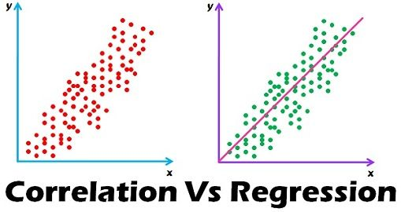
Correlation is described as the analysis which lets us know the association or the absence of the relationship between two variables ‘x’ and ‘y’.
Regression analysis, predicts the value of the dependent variable based on the known value of the independent variable, assuming that average mathematical relationship between two or more variables.

